Slide 1
Data Analytics: Module-3.1
Dr. Ramen Pal Associate Professor Department of CSE (AI & ML), UEMK
Contact: ramen.pal@uem.edu.in WhatsApp: 7501038078

Slide 2
Course Details
Subject Name: Professional Elective - III : Data Analytics
Credit: 3
Subject Code: PECCSE602A
Lecture Hours: 36

Slide 3
Course Outcome
On completion of the course students will be able to:
CO-1: Discuss with illustration the techniques and methods related to the area of data collection, pre-processing, and exploratory data analytics.
CO-2: Discuss important terms and techniques on statistics to enable student to understand the background of different tools or methods used in data analytics.
CO-3: Use at beginning level of proficiency on the tools of machine learning to ask questions of and explore patterns in data.
CO-4: Demonstrate intermediate proficiency in the visualization of data to communicate information and patterns that exist in the data.

Slide 4
Syllabus: Module-3 (Foundation of Machine Learning)
Introduction, types of machine learning (supervised learning, unsupervised learning, and reinforcement learning) regression Regression (Linear, Logistic, Ridge, and Polynominal), Classification, Naïve bias classifier, KNN, Support Vector Machine, clustering, K-Means, ISODATA, Unconstrained optimization, Necessary and sufficiency conditions for optima, Optimization Models (Integer, Nonlinear, and Discrete), Gradient descent methods, Constrained optimization, KKT conditions, Introduction to nongradient techniques, Introduction to least squares optimization, Heuristic optimization, Meta-heuristic optimization. Introduction to ANN, Feed Forward Neural Network, Feedback Neural Network

Slide 5
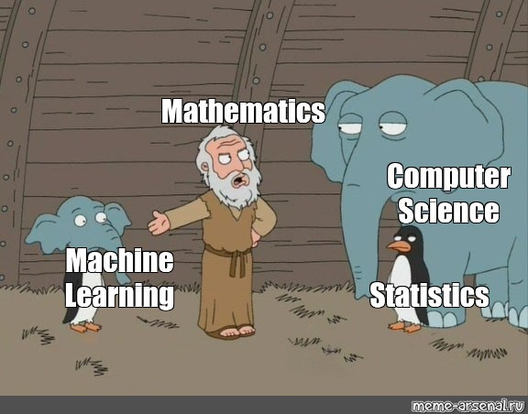
Perquisite

Slide 6
Course Objective
Apply quantitative modeling and data analysis techniques to the solution of real world business problems, communicate findings, and effectively present results using data visualization techniques.
Recognize and analyze ethical issues in business related to intellectual property, data security, integrity, and privacy.

Slide 7
Course Outcome (CO)
CO1 | : | Understand the process and components of Data Science project.
CO2 | : | Learn the importance of probability and statistics in Data Science
CO3 | : | Understand the machine learning in today’s business world.
CO4 | : | Understands the various components of computer science being used for Data Science
CO5 | : | Understand the execution flow of a Data Science project

Slide 8
What is Machine learning ?
“Machine Learning said to learn from experience with respect to some class of tasks, and a performance measure P, if [the learner’s] performances at tasks in the class, as measured by P, improves with experience. ”
Tom Mitchell 1997
The scientific discipline of machine learning enables computers to learn without explicit programming. One of the most intriguing technologies that has ever been developed is machine learning. The ability to learn is what, as the name suggests, gives the computer a more human-like quality. Today, machine learning is being actively used, possibly in a lot more places than one might think.

Slide 9
Three Components
Class of Tasks: T
Input –
a set of instances d₁, d₂, …d_{n}
we can represent an instance as a vector d=< d₁, d₂, …d_{n}>
Output –
A set of predictions y₁, y₂, …y_{n} (in hat notation)
Performance measure: P
Experience: E

Slide 10
Machine Learning Paradigms
Supervised Learning
Learn an input and output map
Classification : - Categorical output
Regression : - Continuous output
Unsupervised Learning
Discover patterns in the data
Clustering: Cohesive grouping
Association: Frequent concurrence
Reinforced learning
Learning Control
Semi-supervised learning

Slide 11


Machine Learning Paradigms

Slide 12
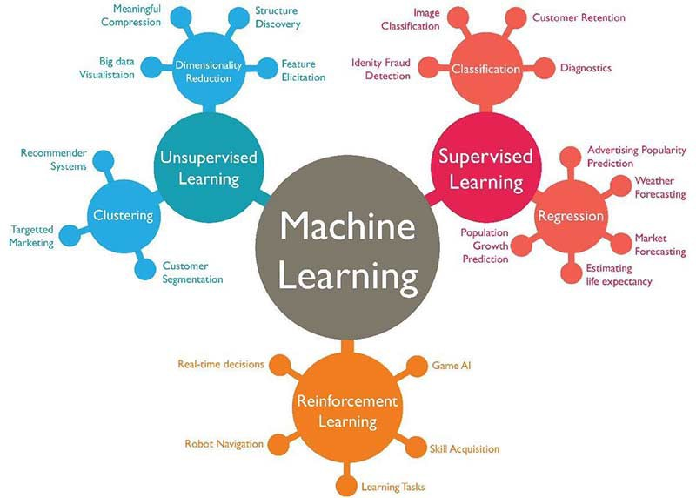

Slide 13
Supervised Learning Algorithm
An AI system is presented with data which is labeled, which means that each data tagged with the correct label.
The goal is to approximate the mapping function so well that when you have new input data (x) that you can predict the output variables (Y) for that data.
As shown in the next example, we have initially taken some data and marked them as ‘Spam’ or ‘Not Spam’. This labeled data is used by the training supervised model, this data is used to train the model.
Once it is trained we can test our model by testing it with some test new mails and checking of the model is able to predict the right output.

Slide 14
Hypothesis
NULL Hypothesis: Some people will claim something. You are assuming that their claim is right. You will try to prove it.
Alternative Hypothesis: Some people will claim something. You are assuming that their claim is wrong. You will try to disprove it.

Slide 15
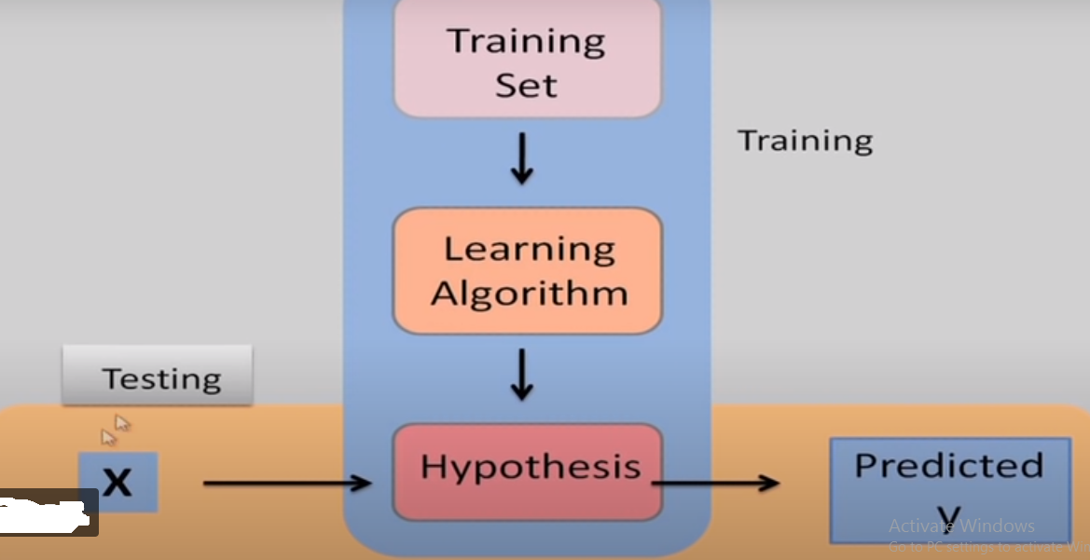

Slide 16
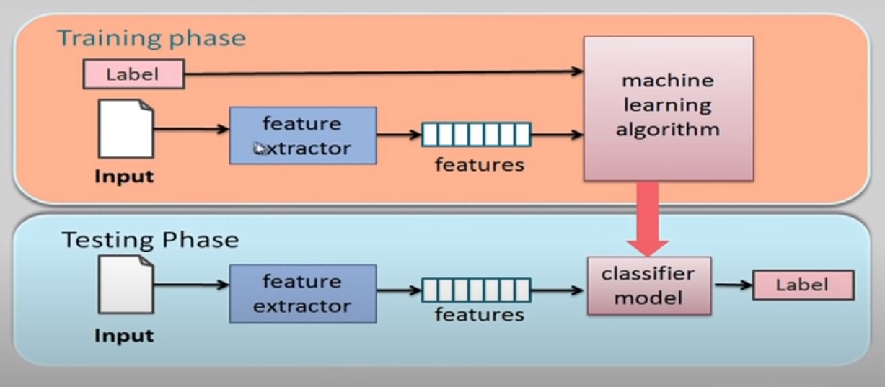

Slide 17
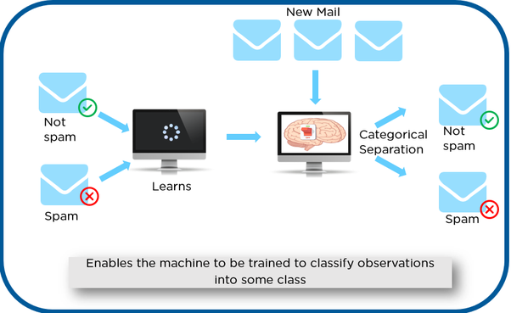
Types of Supervised learning
Classification: (O/P is Discrete) A classification problem is when the output variable is a category, such as “red” or “blue” or “disease” and “no disease”.
Regression: (O/P is Continuous) A regression problem is when the output variable is a real value, such as “dollars” or “weight”.

Slide 18
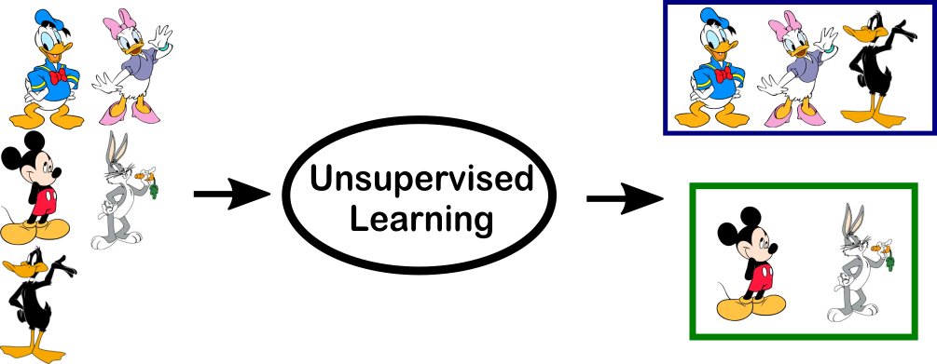
Unsupervised Learning
In unsupervised learning, an AI system is presented with unlabeled, uncategorized data and the system’s algorithms act on the data without prior training. The output is dependent upon the coded algorithms. Subjecting a system to unsupervised learning is one way of testing AI.

Slide 19
Types of Unsupervised learning
Clustering: A clustering problem is where you want to discover the inherent groupings in the data, such as grouping customers by purchasing behavior.
Association: An association rule learning problem is where you want to discover rules that describe large portions of your data, such as people that buy X also tend to buy Y.

Slide 20
Reinforcement Learning
Learns by interacting with its environment.
Receives rewards by performing correctly and penalties for performing incorrectly.
No intervention with a human by maximizing its reward and minimizing its penalty.
Dynamic programming that trains algorithms using a system of reward and punishment.

Slide 21

Here, we can see that the agent is given 2 options i.e. a path with water or a path with fire. A reinforcement algorithm works on reward a system i.e. if the agent uses the fire path then the rewards are subtracted and agent tries to learn that it should avoid the fire path. If it had chosen the water path or the safe path then some points would have been added to the reward points, the agent then would try to learn what path is safe and what path isn’t.
It is basically leveraging the rewards obtained, the agent improves its environment knowledge to select the next action.

Slide 22
Challenges
How good is model ?
How do I choose a model ?
Do I have enough data ?
Is the data of sufficient quality ? (Noise in images)
How confident can I be of the results ?
Am I describing the data correctly ?
Are age and income enough ? Should I look at gender also ?
How should I represent age ? As No. or linguistic variable ?

Slide 23
Linear Regression
X belong to p- dimensional real space
y is real number
P_{r}(x,y) - Probability Joint distribution
{(x₁, y₁)
(x₂, y₂),
...
(x_{N}, y_{N})}
f(x): p- dimensional real space -> real number

Slide 24
Linear regression
Estimated (y)= f(X) = b₀+b₁x₁+b₂x₂ + ….. + b_{p}x_{p}
x₁, x₂, … are coordinate of X.
X=(x₁, x₂, x₃, …, x_{p}) – Different attributes of X, which describes the data (age, income, …).
So f(x)= b0 +

Slide 25
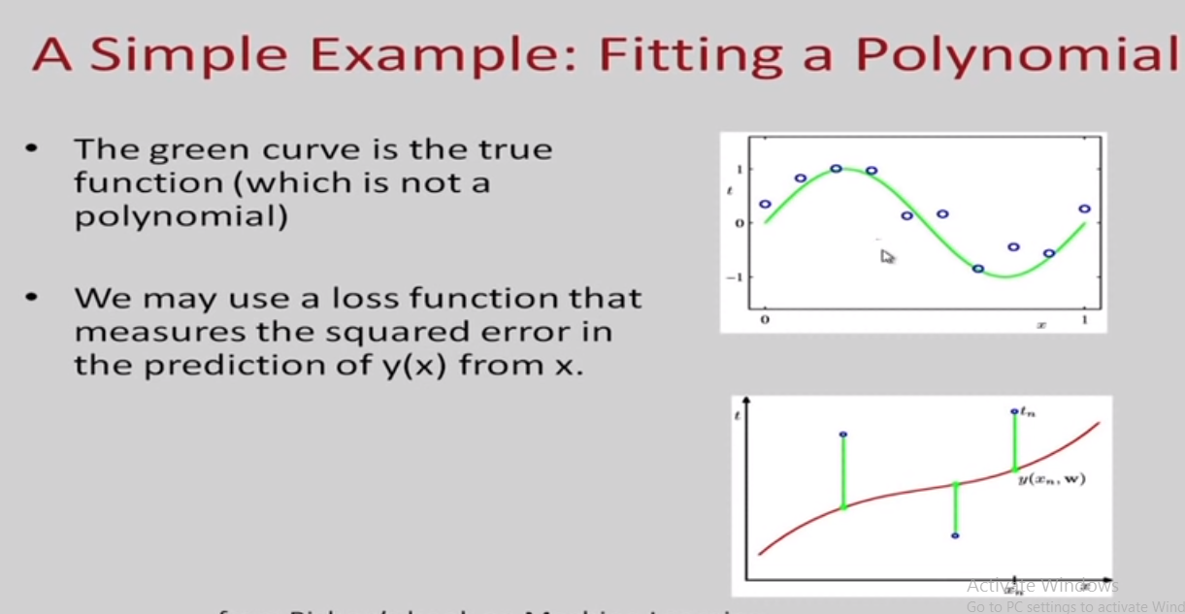

Slide 26
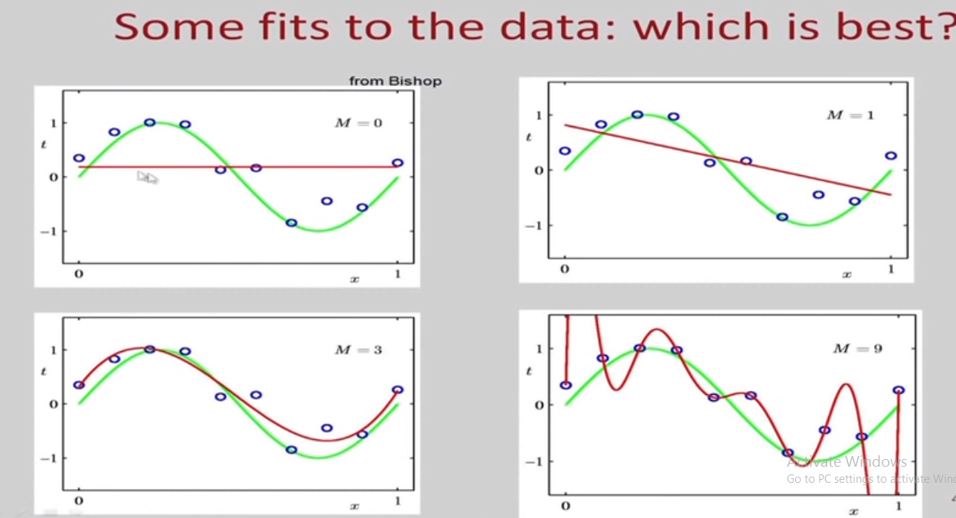

Slide 27
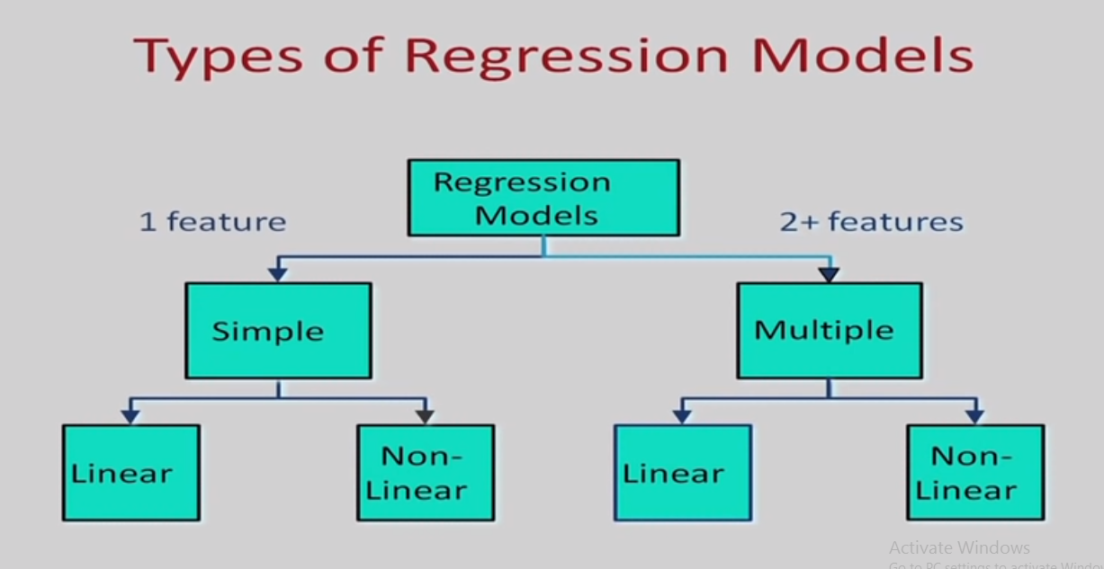

Slide 28
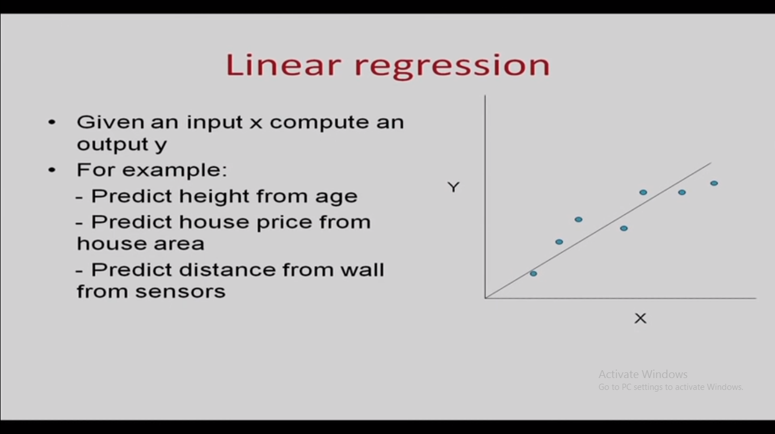

Slide 29
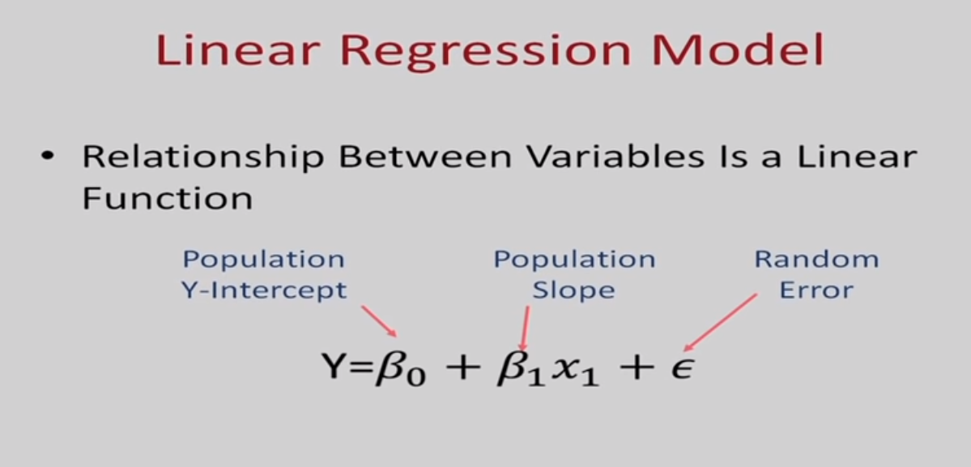

Slide 30
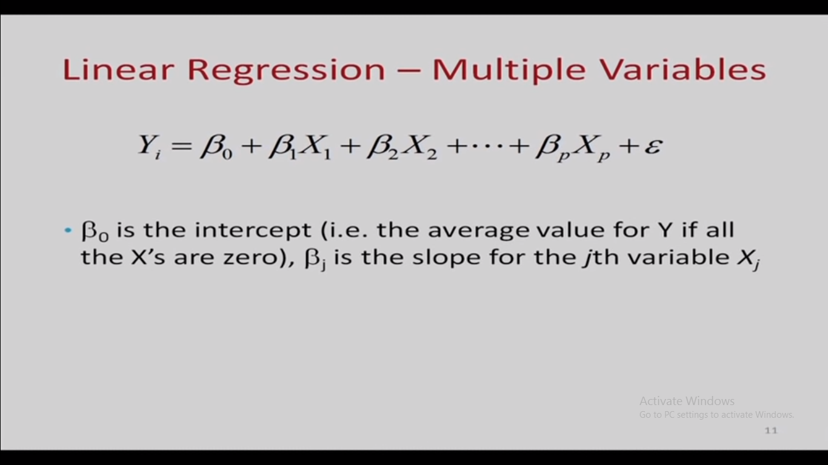

Slide 31
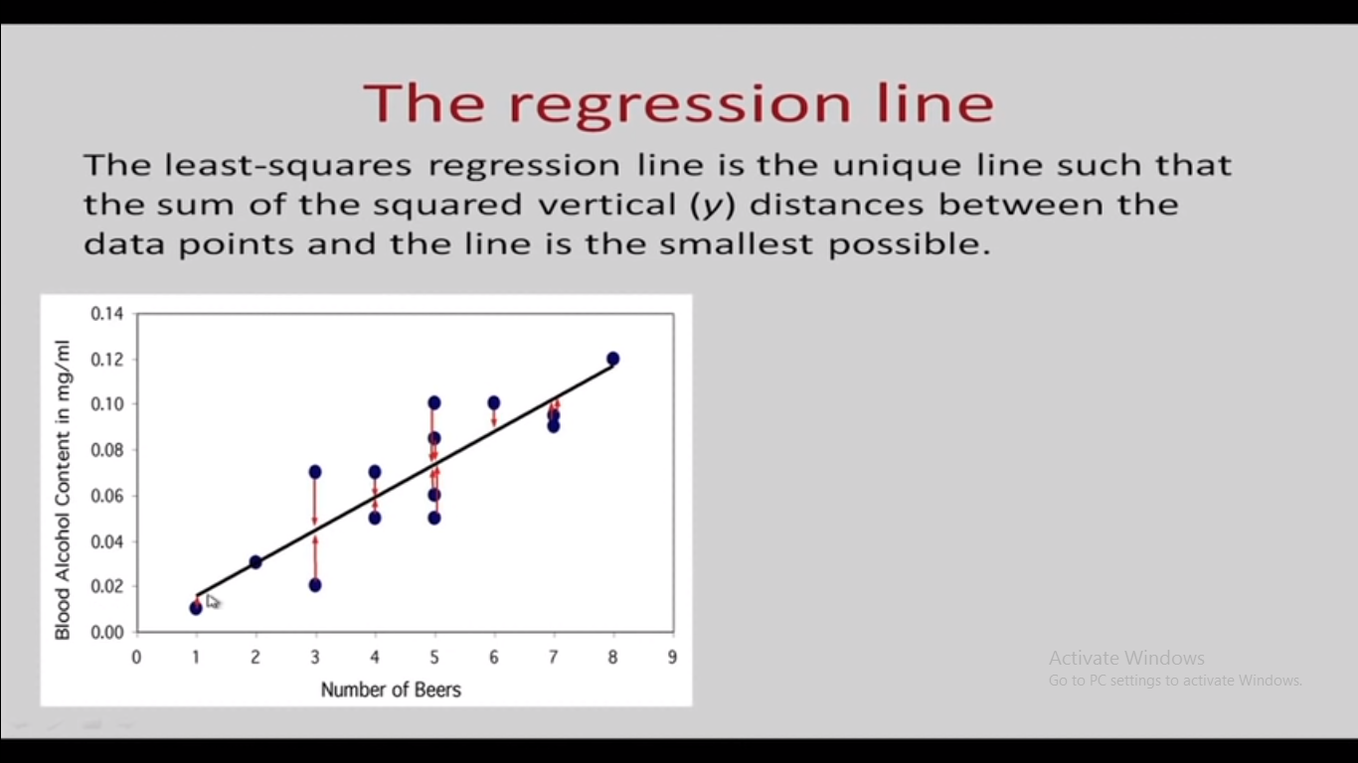

Slide 32
